Slide 1
PLC Based Temperature and On-Off Control of Dual Motor System
Presented by - Date: 30.06.2024
Akash Mukherjee
Supratit Das

Slide 2
Introduction
Industrial automation is essential for efficient and precise control in manufacturing processes.
Hydraulic systems are widely used in various industrial applications for their high power density and reliability.
This project focuses on designing and implementing a PLC-based control system for a dual motor setup to simulate an electro-hydraulic system with temperature control.

Slide 3
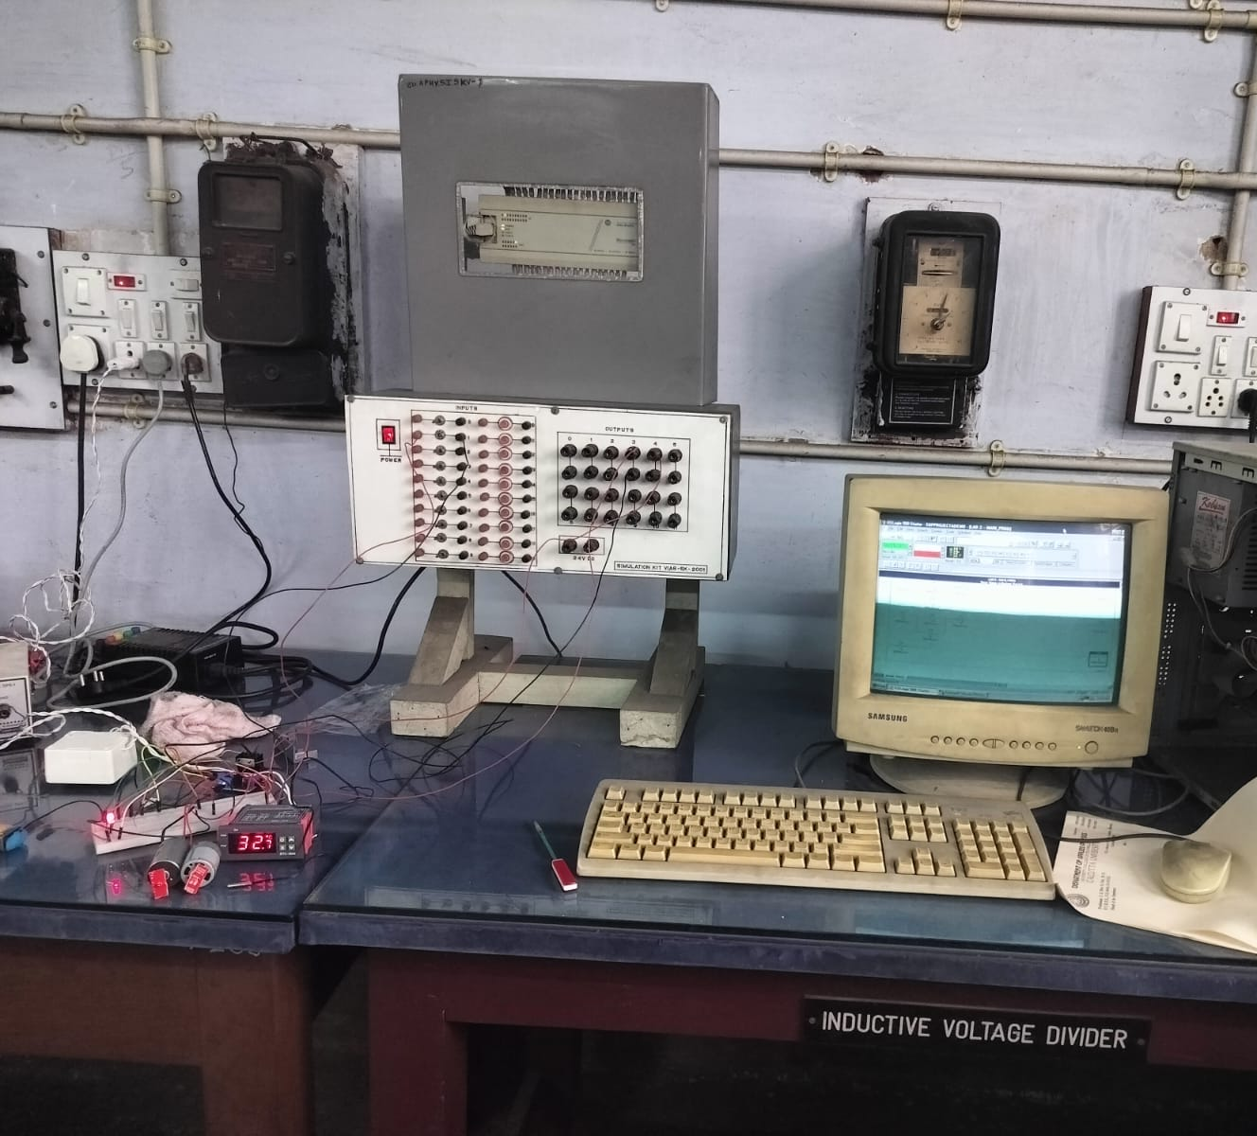
Project Aim
This project aims to understand the fundamental of industrial automation and develop a electro-hydraulic system in lab environment.
For this we developed a dual motor system synchronized to each other and controlled by a PLC.
The project also aims to incorporate a safety mechanism by using PLC
Pic: Picture of Whole setup of the project

Slide 4

Hydraulic system
Hydraulic systems are crucial in many industrial applications due to their ability to provide significant force and precise control.
Basic components include:
Hydraulic Fluid: Transmits power within the system.
Reservoir: Stores the hydraulic fluid.
Pumps: Move the fluid through the system, converting mechanical power to hydraulic energy.

Slide 5
Hydraulic System In Our Project
Developed dual motor system which represents the two pumps in hydraulic system .
First motor needs to be turned on first before turning on the second motor.
If the first motor is turned off, second motor will be turned off automatically.

Slide 6
Programmable Logic Controller(PLC)
PLC is one of the most important tool in industrial automation.
PLC is used to control small or medium sized process in industries. PLCs are also hugely used for industrial safety integration.
Some leading members of PLC manufacturers are Siemens, ABB, Allen Bradley, Delta, Mitsubishi, Emerson, Schneider Electric etc.

Slide 7
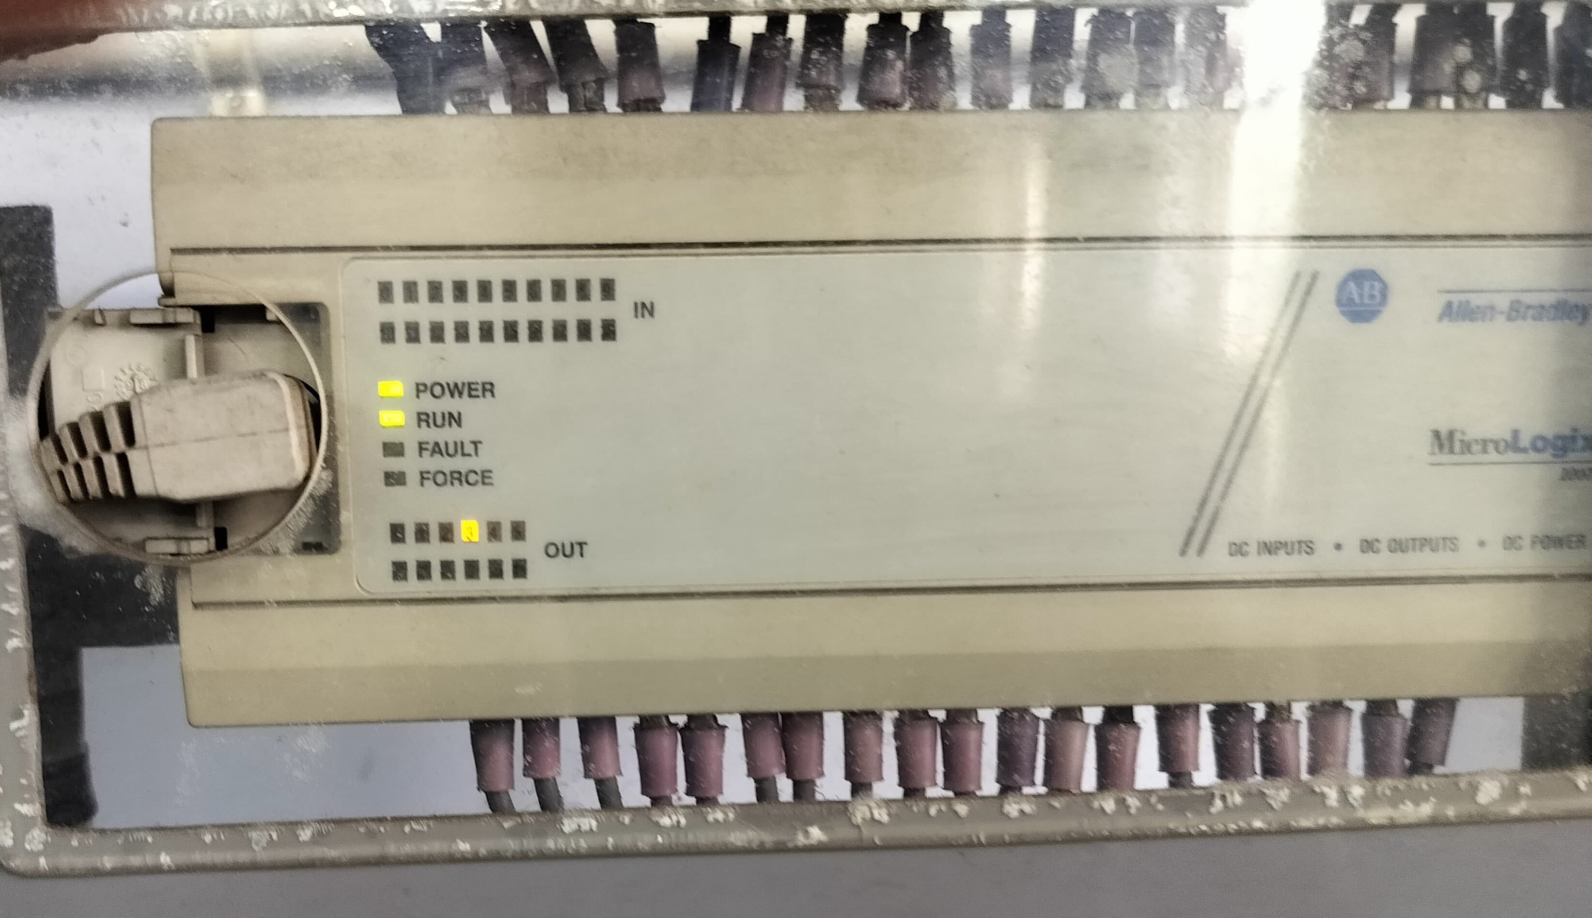
Allen-Bradley 1761 MicroLogix 1000
We utilized the Allen-Bradley 1761 MicroLogix 1000 PLC in our project.
It has 20 inputs and 12 outputs port.
PLC is integrated with a shoebox containing 20 inputs(10 switches+10 push buttons) and 12 Outputs.
Allan-Bradley 1761 MicroLogix 1000

Slide 8
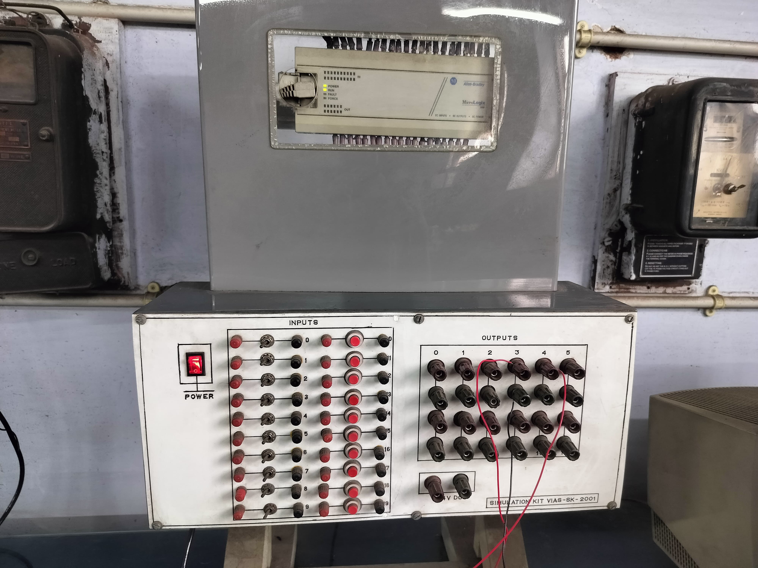
Allen-Bradley PLC with Shoebox

Slide 9
RSLogix 1000
RSLogix 1000 software is provided by Allen-Bradley.
We programmed our PLC with ladder logic using this software.
Works as HMI where we can run and see the operation of the PLC.
We can also check the ladder logic by simulation.

Slide 10
Project Details
We developed a dual synchronized motor system controlled by PLC.
Both motors can be turned on and off by push buttons.
Second motor can be turned on only if first motor is on.
If first motor is turned off second motor will also be turned off automatically.
We developed a temperature safety system using PLC. If the temperature goes above set point both motor will be turned off and an alarm system will turn on.
Alarm system will turn off automatically when temperature goes below reset point .

Slide 11
Components and Cost Estimation
Components | Units | Cost
Allan-Bradley PLC | 1 | 5500
12V DC motors | 2 | 300
Push button | 4 | 50
Temperature controller(STC-1000) | 1 | 300
Motor driver(L298N) | 1 | 100
Jumper wire | 20 | 40
Red LED | 1 | 10
Total cost |  | 6300

Slide 12
PLC Inputs and Outputs Chart
Input Indication | Significance | Output Indication | Significance
I:0/1 | Temperature controller | O:0/3 | For controlling Motor-1
I:0/10 | Push button-1 for turning on Motor-1 | O:0/4 | For controlling Motor-2
I:0/11 | Push button-2 for turning off Motor-1 | O:0/5 | For controlling alarm system.
I:0/12 | Push button-3 for turning on Motor-2
I:0/13 | Push button-4 for turning off Motor-2

Slide 13
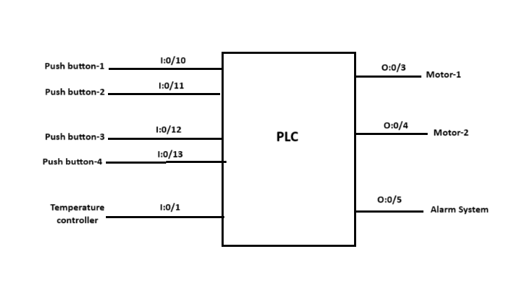
Connection of PLC

Slide 14
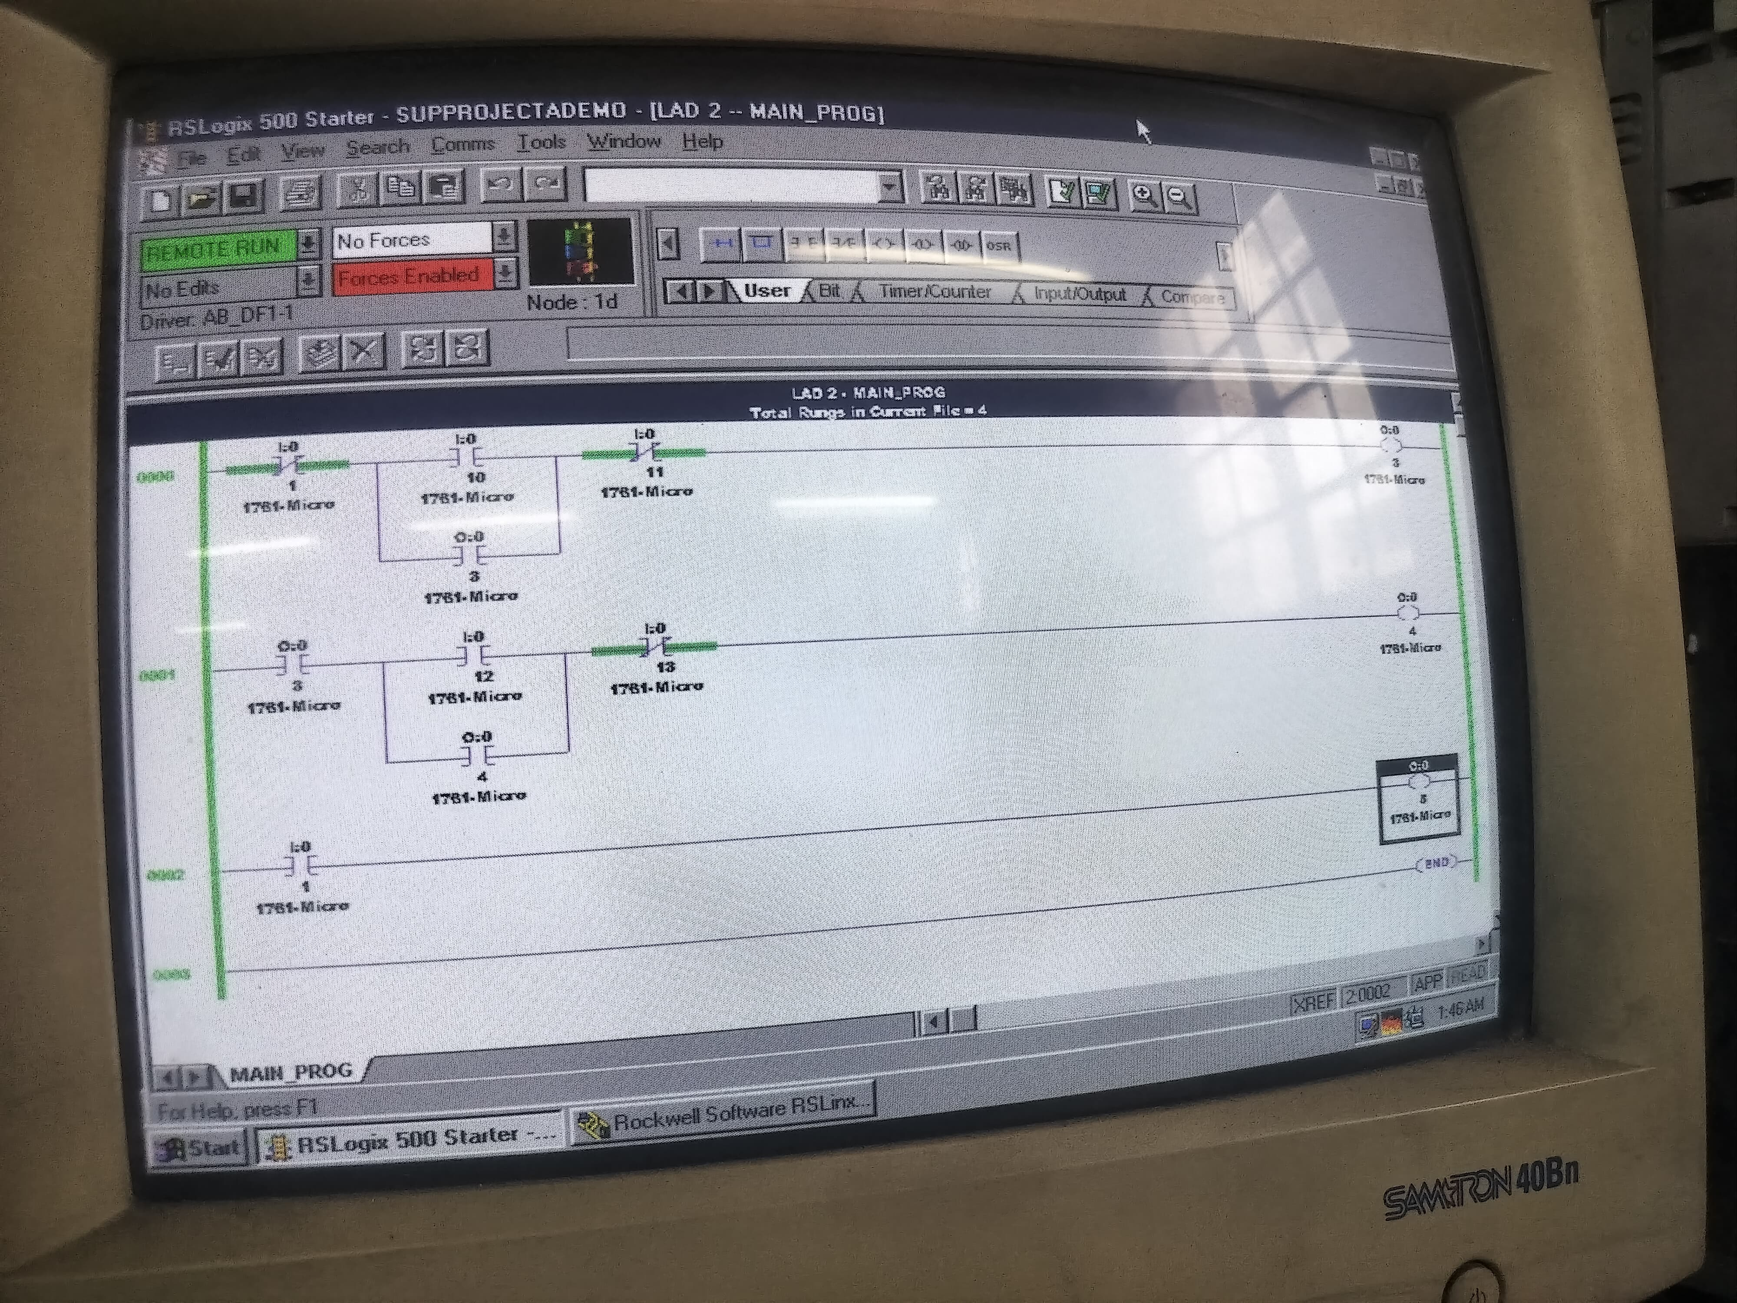
Ladder Logic

Slide 15
Contd.
Rung-1:
➔ Controls Motor-1.
➔ Has 3 inputs- I:0/1, I:0/10, I:0/11
➔Has 1 output- O:0/3

Slide 16
Contd.
Rung-2
➔ Controls Motor-2.
➔ Has 3 inputs- O:0/3, I:0/12,I:0/13
➔Has 1 output – O:0/4

Slide 17
Contd.
Rung-3
➔ Controls alarm system.
➔ Has 1 input – I:0/1 and 1 output O:0/5

Slide 18
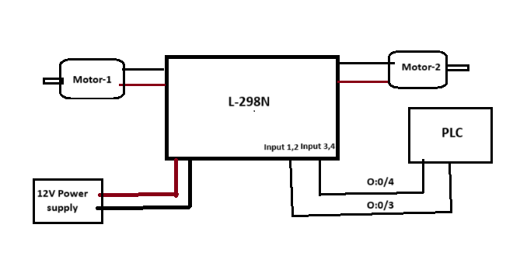
Motor Controlling System

Slide 19
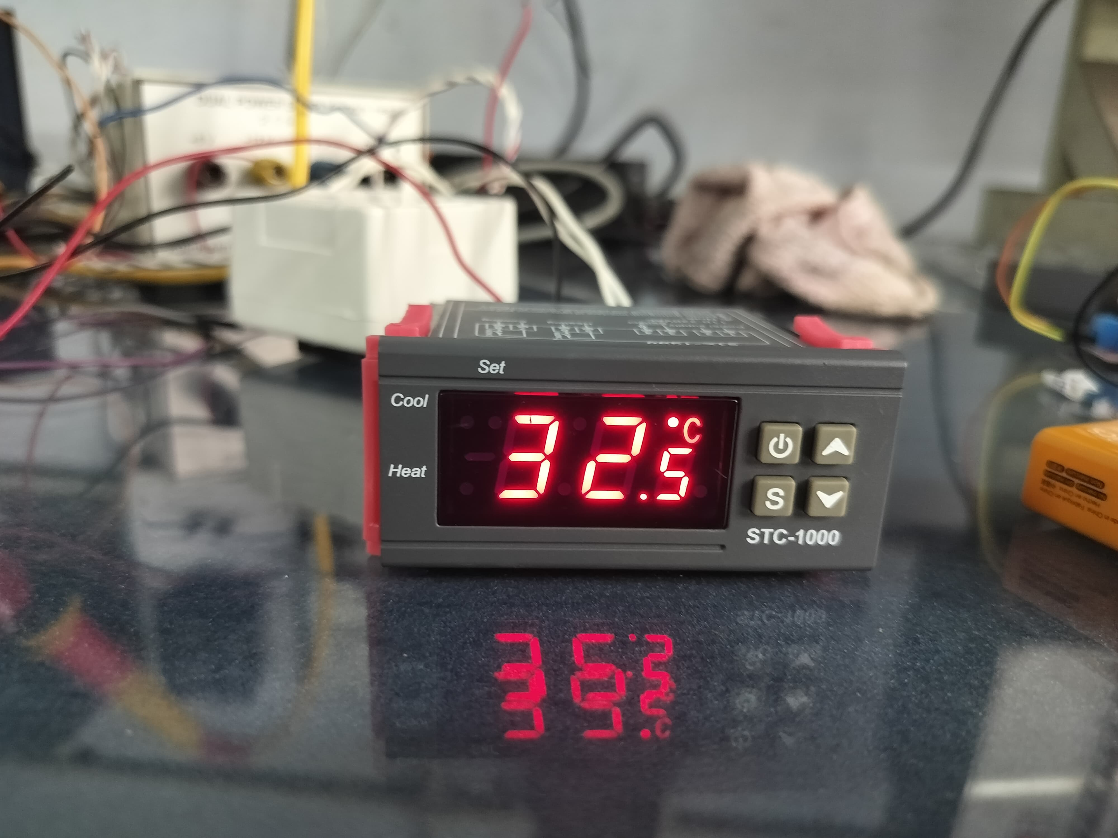
Alarm System
Used STC-1000 as temperature controller.
When temperature goes beyond set temperature (32.5°C) a red LED will turn on to alert us.
When temperature goes beyond reset point(0.3°C), red LED will turn off and alarm is reset.
STC-1000 temperature controller

Slide 20
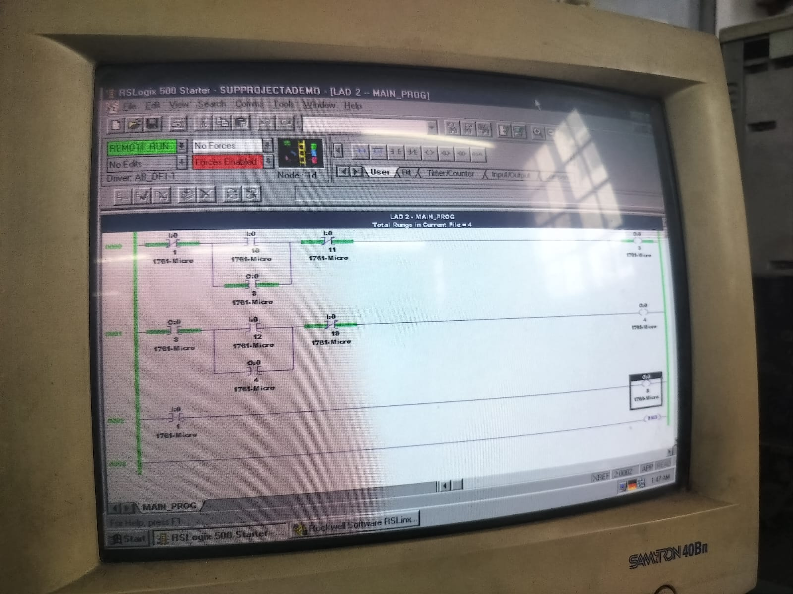
Result
When Motor-1 ON

Slide 21
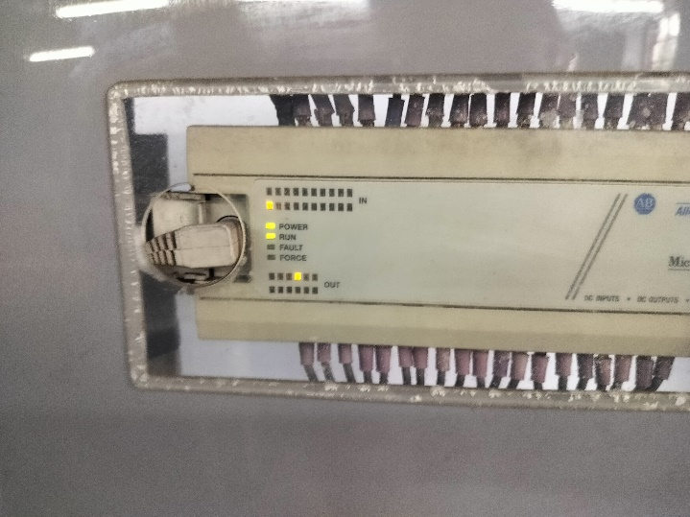
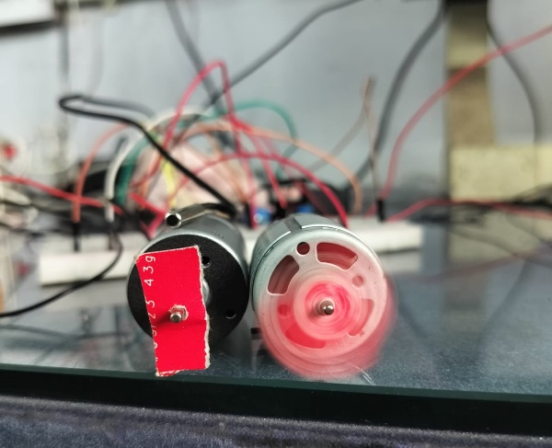
Contd.

Slide 22
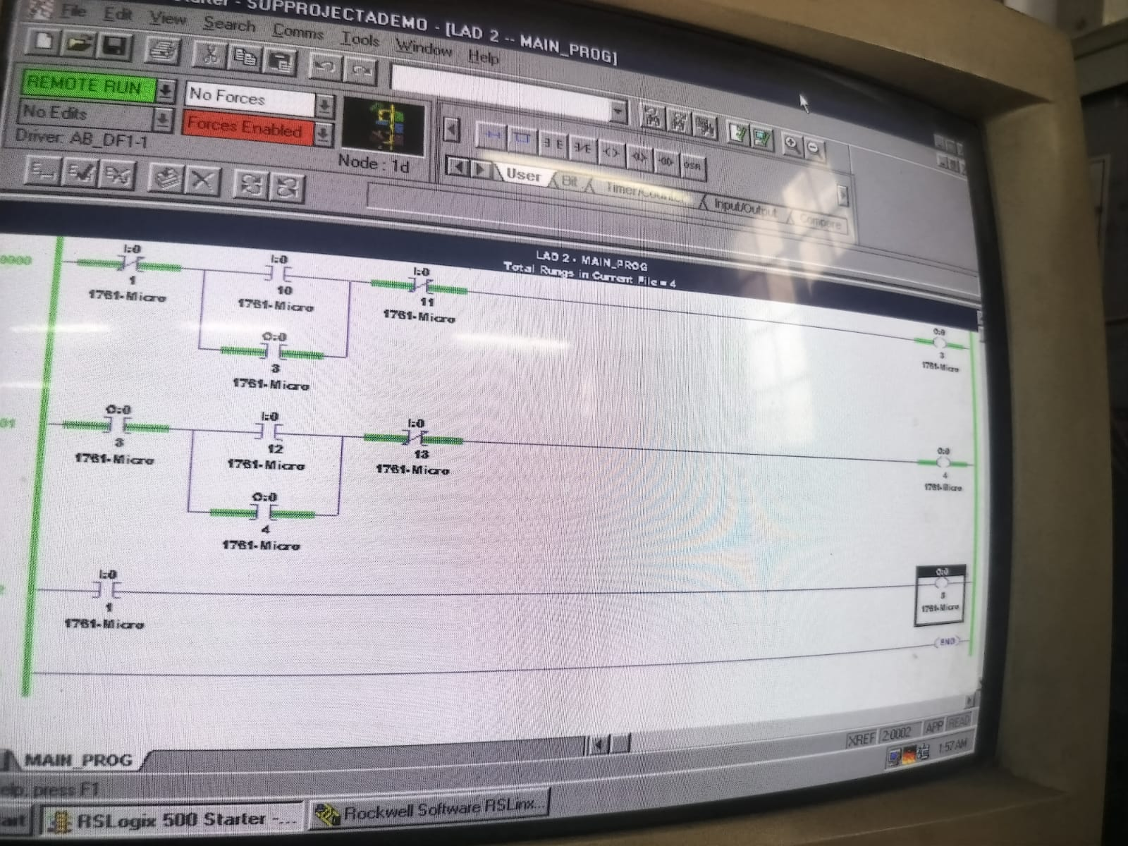
Contd.
When Motor-2 ON

Slide 23
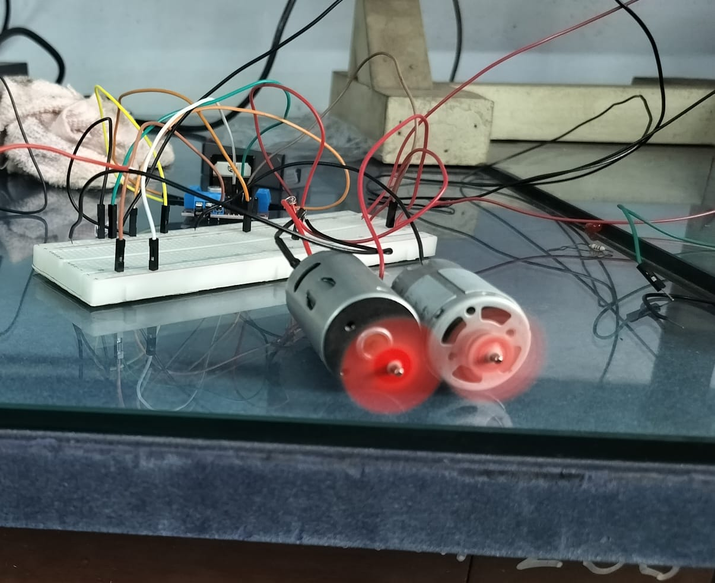
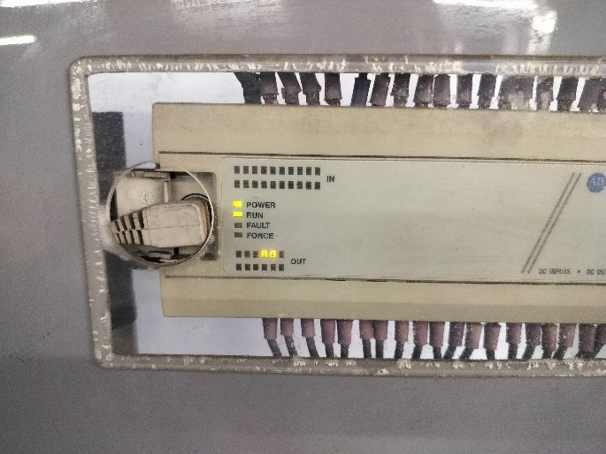
Contd.

Slide 24
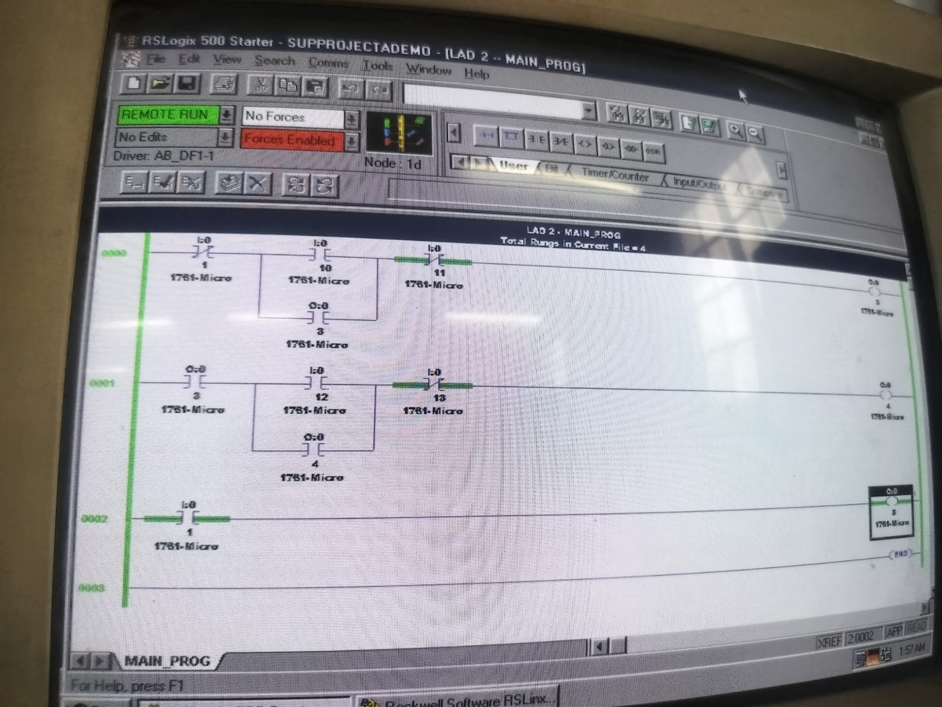
Contd.
Alarm system on

Slide 25
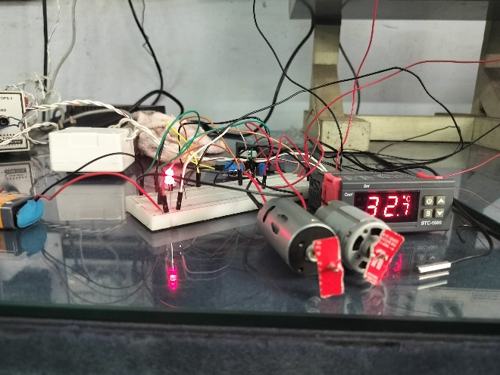
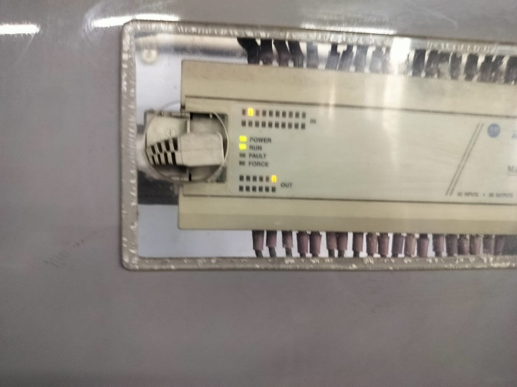
Contd.

Slide 26
Conclusion
In conclusion, our project demonstrates the successful integration and synchronization of a dual motor control system using a PLC, enhanced by a robust safety mechanism through the STC-1000 temperature controller.
The hands-on experience with temperature control, motor driver integration, and alarm systems has enriched our understanding of maintaining operational safety and reliability in industrial settings.
This project serves as a solid foundation for future endeavours in the field of instrumentation engineering and industrial automation.

Slide 27
Reference
‘Industrial Automation Technologies’ by Dr. Chanchal Dey and Dr. Sunit Kumar Sen
‘Programmable Logic Controllers’ by Frank D. Petruzella
‘PLC Programming with RSLogix 5000’ by Austin Scott
‘PLC Programming Using RSLogix 500: A Practical Guide to Ladder Logic and the RSLogix 500 Environment’ by Nathan Clark
http://ee.ump.edu.my/hazlina/teaching_PLC/teaching_PLC_chap3.pdf
https://repository.dinus.ac.id/docs/ajar/PLC_Beginner_guide.pdf
https://www.tshoshmand.com/images/pdf/PLC/plcapplicationexample.pdf

Slide 28
Thank You

